Slide 1




Understanding and Preventing Phishing Attacks
Phishing attacks are a pervasive threat in today's digital landscape, targeting individuals and organizations alike. This presentation aims to provide a comprehensive overview of phishing, including its definition, various types, attack mechanisms, and effective prevention strategies. By understanding the intricacies of phishing tactics, individuals and organizations can better protect themselves from falling victim to these malicious schemes.
Abhishek Maurya

Slide 2

The Anatomy of a Phishing Attack
Phishing attacks typically involve three key stages: the lure, the hook, and the catch. In the lure stage, attackers create fake emails, websites, or messages designed to deceive victims. The hook involves tactics used to trick victims into clicking malicious links or providing sensitive information. Finally, the catch occurs when victims fall for the scam, leading to data breaches, financial losses, or identity theft.
The Lure
The Hook
The Catch
Fake emails, websites, or messages that appear legitimate.
Tactics used to trick victims into clicking malicious links or providing sensitive information.
Consequences when victims fall for the scam.

Slide 3
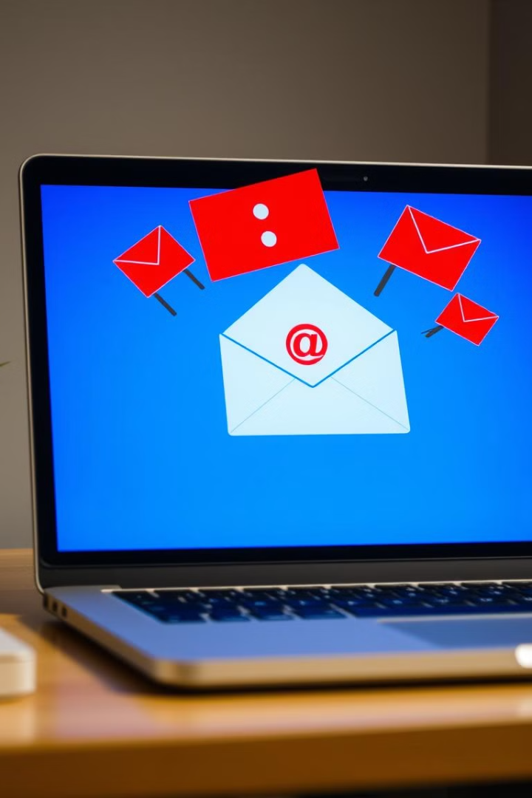

Recognizing Phishing Emails
Identifying phishing emails is crucial for preventing attacks. Common signs include suspicious sender addresses, generic greetings, poor grammar and spelling, and urgent or threatening language. Unexpected attachments or links are also red flags. By being vigilant and aware of these indicators, individuals can avoid falling victim to email-based phishing scams.
1
Suspicious Sender Addresses
Check for unusual or mismatched email addresses.
2
Generic Greetings
Be wary of impersonal greetings like "Dear Customer."
3
Poor Grammar and Spelling
Phishing emails often contain grammatical errors and typos.
4
Urgent or Threatening Language
Beware of emails that pressure you to act quickly.

Slide 4
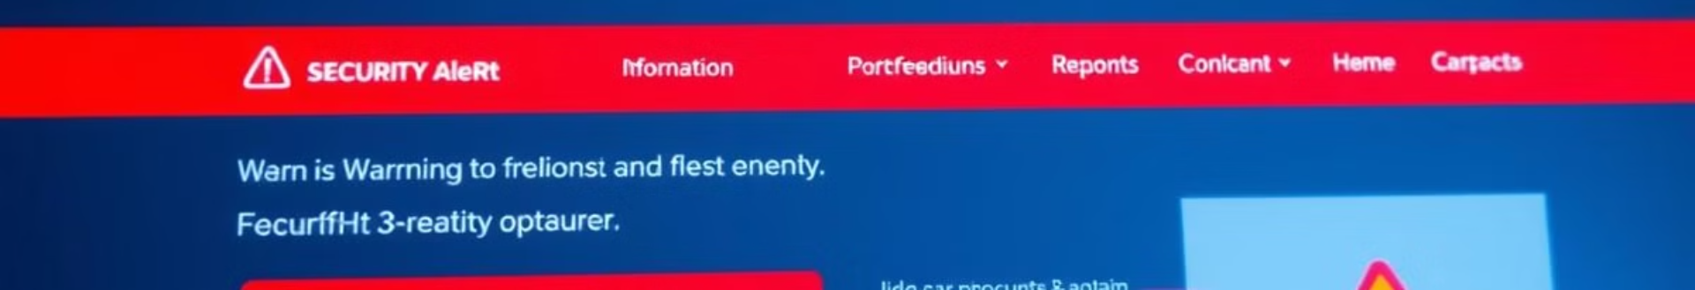

Red Flags on Phishing Websites
Phishing websites often mimic legitimate sites but contain several red flags. Mismatched URLs, unsecured websites without HTTPS, and strange pop-ups are common indicators. Additionally, requests for sensitive information, such as passwords or credit card details, should raise suspicion. Always verify the authenticity of a website before entering any personal information.
Mismatched URLs
Unsecured Websites (No HTTPS)
Check for subtle differences in the website address.
Look for the padlock icon and "HTTPS" in the address bar.
Strange Pop-Ups
Requests for Sensitive Information
Be cautious of unexpected pop-up windows.
Never enter personal details on unverified websites.

Slide 5






Common Social Engineering Techniques
Social engineering tactics are used to manipulate individuals into divulging sensitive information or performing certain actions. Common techniques include pretexting (creating a false scenario), baiting (offering something enticing), quid pro quo (offering a service), tailgating (gaining unauthorized access), and impersonation (pretending to be someone else). Understanding these tactics is crucial for recognizing and avoiding social engineering attacks.
Pretexting
Baiting
Quid Pro Quo
Creating a false scenario to trick victims.
Offering something enticing to lure victims.
Offering a service in exchange for information.
Tailgating
Gaining unauthorized access by following someone.

Slide 6

Best Practices to Protect Yourself from Phishing Attacks
Protecting yourself from phishing attacks requires a proactive approach. Double-check sender information, hover over links to check URLs, and avoid sharing personal information online. Keep software and security measures updated, and report any suspected phishing attempts. By following these best practices, individuals can significantly reduce their risk of falling victim to phishing scams.
1
Double-Check Sender Information
Verify the sender's identity before trusting an email.
2
Hover Over Links to Check URLs
Preview the destination of a link before clicking.
3
Avoid Sharing Personal Information Online
Be cautious about providing sensitive details.
4
Keep Software Updated
Regular updates patch security vulnerabilities.

Slide 7





Real-Life Case Studies
Examining real-life examples can highlight the impact and sophistication of phishing attacks. One notable case is the Republican National Committee Breach (2021). In July 2021, the Republican National Committee (RNC) found itself in the crosshairs of Cozy Bear, a Russian-affiliated hacking group linked to the SVR. Hackers infiltrated accounts tied to the RNC using a third-party IT provider called Synnex. Such incidents underscore the need for robust security measures and continuous vigilance.
Initial Intrusion
Cozy Bear infiltrates accounts tied to the RNC.
Third-Party Vulnerability
Attackers exploit Synnex, a third-party IT provider.
Data Breach
Sensitive information is compromised.

Slide 8




Conclusion: Staying Vigilant
In conclusion, phishing attacks pose a significant threat that requires ongoing vigilance. By understanding the tactics used by attackers and implementing best practices for protection, individuals and organizations can minimize their risk. Staying informed and updated about the latest phishing trends is essential for maintaining a strong defense against these evolving threats. Continuous vigilance is key to safeguarding sensitive information and preventing costly breaches.
2
Implement Practices
1
Understand Tactics
Stay Informed
3

Slide 9

Resources and Further Reading
To further enhance your understanding and protection against phishing attacks, explore the following resources. These links provide additional information, trusted websites, and insightful articles. Continuous learning and staying informed are vital components of a robust cybersecurity strategy. Take advantage of these resources to strengthen your defenses and remain vigilant against evolving phishing threats.
Phishing ppt | PPT
Phishing attack seminar presentation | PPT
Phishing attacks ppt | PPT

Slide 10

Thank You

